Slide 1
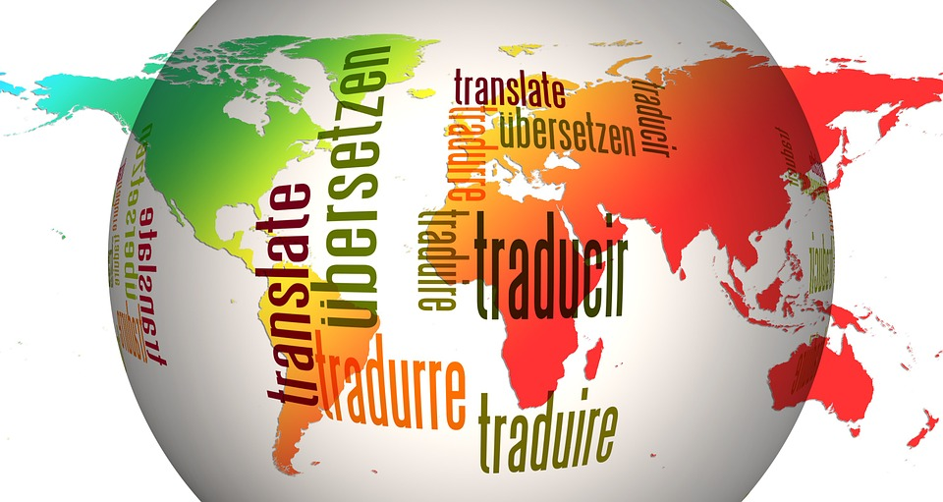
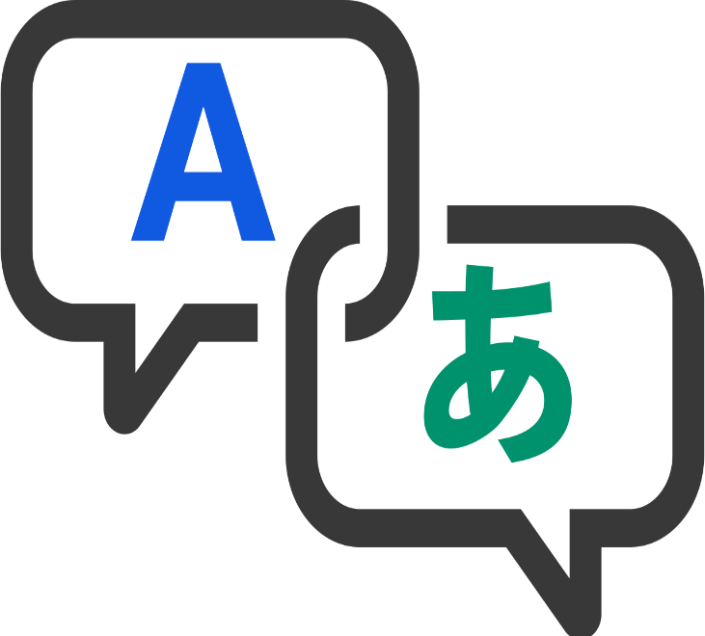
LANGUAGE TRANSLATOR USING GOOGLE API
PROJECT BY : NISHANT PUNDIR
LALIT SINGH BHOJAK
RISHABH GUPT
NEETA RAWAT
MAHAK GARG
HEMANT VERMA

Slide 2
CONTENT
OBJECTIVE OF THIS PROJECT
PROJECT PREREQUISITES
STEPS TO BUILD THE LANGUAGE TRANSLATOR
PROJECT OUTPUT
CODE SNAPSHOTS
ADVANTAGES
SUMMARY
REFERENCES

Slide 3
OBJECTIVE OF THIS PROJECT
A language translator or text translator is a tool to translate text, words, phrases from one language to any other language. It is like a dictionary where we can translate the text.
The objective of this project is to translate text from one language to any other language in real-time with a button click. This project will be built using the Tkinter, googletrans and Textblob libraries.
In this project, the user enters text in any language and get it translated in any other language by selecting the output language.

Slide 4
PROJECT PREREQUISITES
To implement this project, we will use the basic concepts of Python, Tkinter, and googletrans libraries.
Tkinter is a standard GUI Python library. ttk module gives access to the Tk themed widget set.
Googletrans is a module to translate text. We import the Translator from googletrans, which is used to do translations. We also import LANGUAGES from googletrans which lists all supported languages in a Python dictionary.
TextBlob is a Python (2 and 3) library for processing textual data. It provides a simple API for diving into common natural language processing (NLP) tasks such as part-of-speech tagging, noun phrase extraction, sentiment analysis, classification, translation, and more.

Slide 5
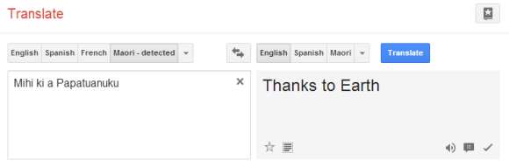
STEPS TO BUILD THE LANGUAGE TRANSLATOR
Import required modules.
Create a display window.
Create input and output text widget.
Define Combobox to select a language.
Define function.
Create a translate button.

Slide 6
1. Import Modules
We import ttk modules from tkinter library and Translator, LANGUAGES modules from googletrans library.
2. Create a display window
We use tkinter library to create a window where we’ll enter the text which we want to convert into voice.
Tk() initialized tkinter which means window created
geometry() set the width and height of the window
resizable(0,0) set the fixed size of the window
bg = ‘’ use to set the background color
title() used to set the title of the window
Label() widget use to display one or more than one line of text that users aren’t able to modify.

Slide 7
3. Create an Input-output text widget
Text() widget is used for multiple text lines.
wrap = WORD will stop the line after the last word that will fit.
padx puts an extra bit of space to the left and right of the widget.
pady adds an extra bit of space to the top and bottom.
4. Define Combobox to select the language
language gets all the values from the ‘LANGUAGES’ dictionary in the form of a list.
ttk.Combobox() widget is a class of ttk modules. It is a drop-down list, which can hold multi-value and show one item at a time. Combobox is useful to select one option from many option.

Slide 8
5. Define Function
The Translate function will translate the message and give the output.
src gets the language selected as input text language.
dest gets the language select to translate.
text gets the input text entered by the user.”1.0″ means that the input should be read from zero characters to line one.
The END part means to read the text until the end is reached.
translator = Translator() used to create a Translator class object.
Output_text.delete(1.0, END) delete all the text from line one to end.
Output_text.insert (END, translated.text) will insert the translated text in Output_text.

Slide 9
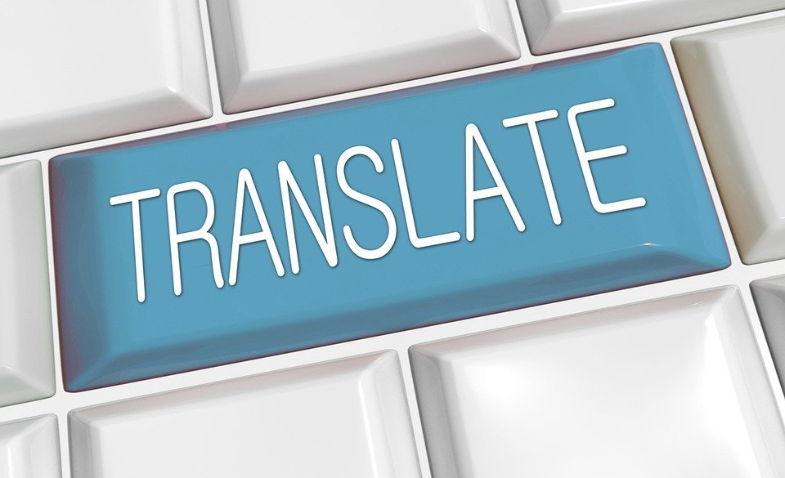
6. Create a translate button
Button() widget used to display button on our window
command is called when we click the button
activebackground sets the background color to use when the button is active

Slide 10
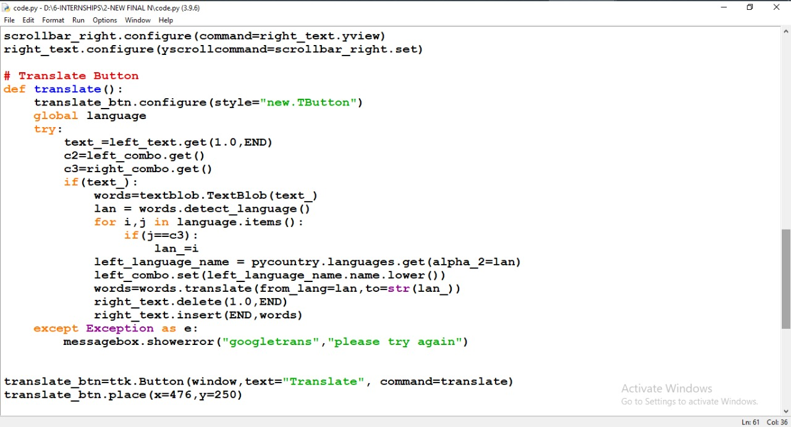
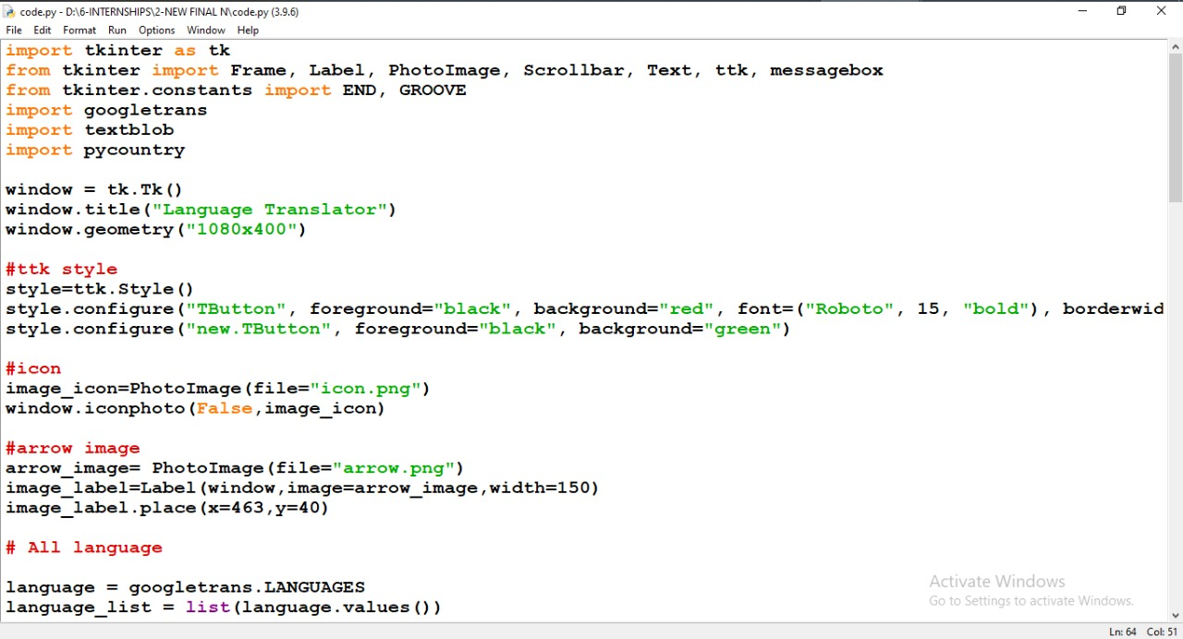
CODE SNAPSHOTS

Slide 11
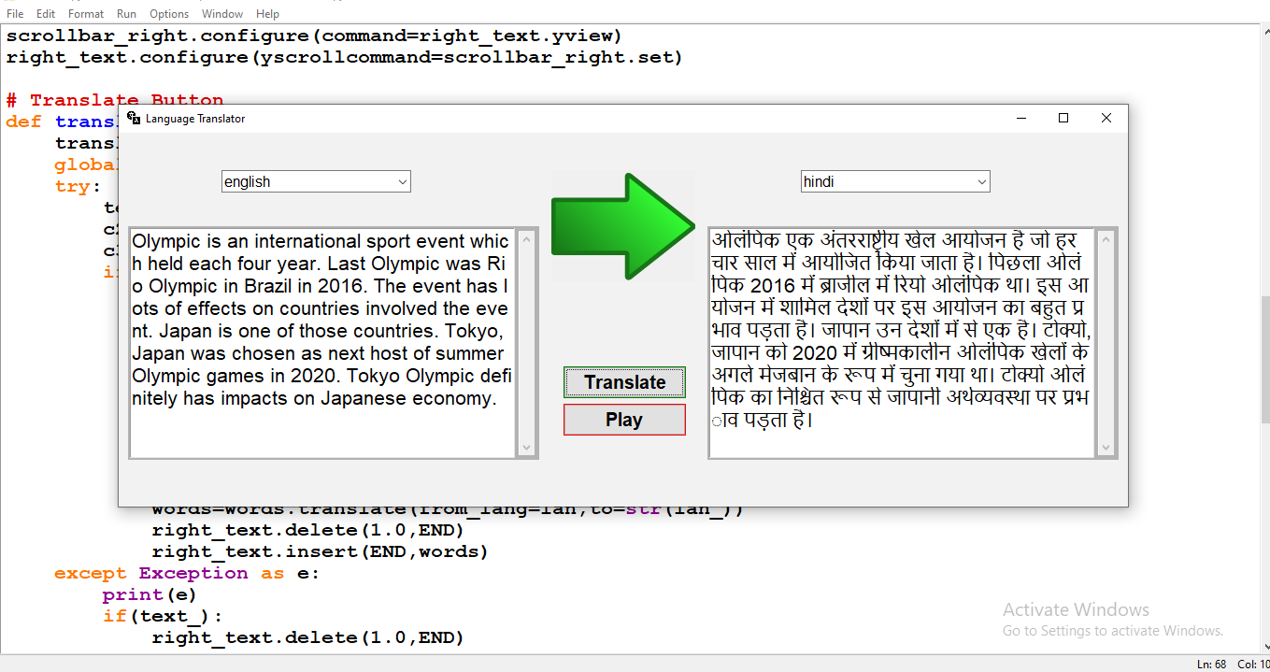
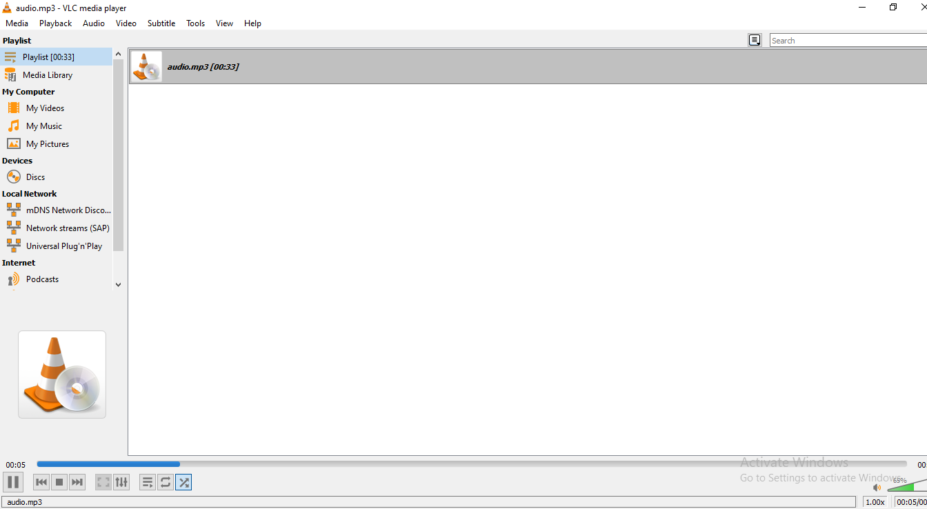
PROJECT OUTPUT 1

Slide 12
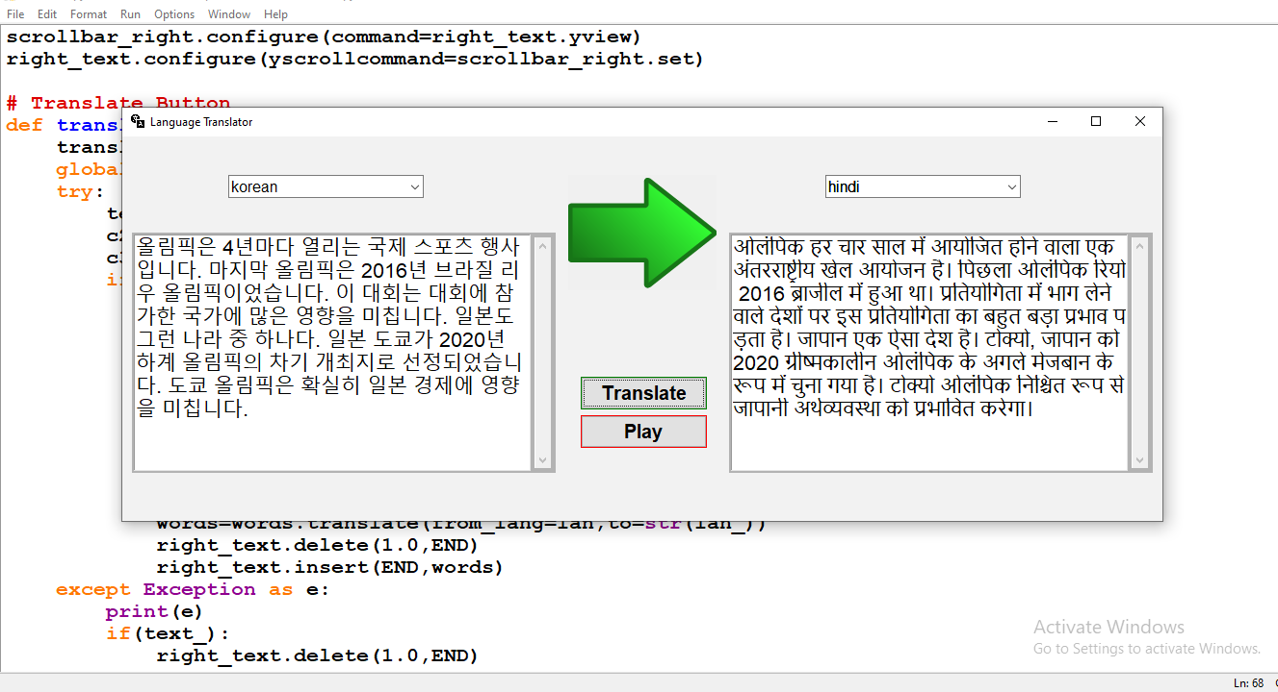
PROJECT OUTPUT 2

Slide 13
ADVANTAGES
It is free. An experienced professional translator can sometimes be costly.
It is very fast.
The performance of the TextBlob is good .
TextBlob Support is excellent and useful.

Slide 14
DISADVANTAGES
It makes mistakes ,while the tool does translate words there are often mistakes, particularly with grammar, structure, and context.
There's no quality control .

Slide 15
DAILY USES AND REQUIREMENTS
Keeping informed about what’s happening in the world.
Expanding our cultural horizons.
Translation can help save lives .
Supporting economic interaction across borders.
Keeping us entertained

Slide 16
SUMMARY
We have successfully developed the Language Translator python project. We used the popular tkinter library for rendering graphics on a display window, googletrans library to translate text from one language to another.
We learned how to translate text, how to create Combobox, buttons widget, and pass the function to the button. In this way, we build a Language Translator.

Slide 17
REFERENCES
https://projectgurukul.org/python-language-translator/
https://www.geeksforgeeks.org/language-translator-using-google-api-in-python/
https://textblob.readthedocs.io/en/dev/
https://py-googletrans.readthedocs.io/en/latest/

Slide 18


